Slide 1
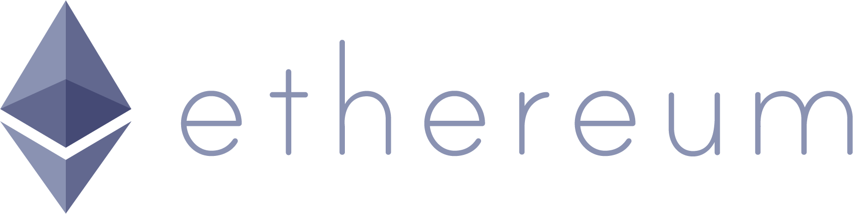
And decentralized applications
LECTURER: ZVEZDIN BESARABOV

Slide 2
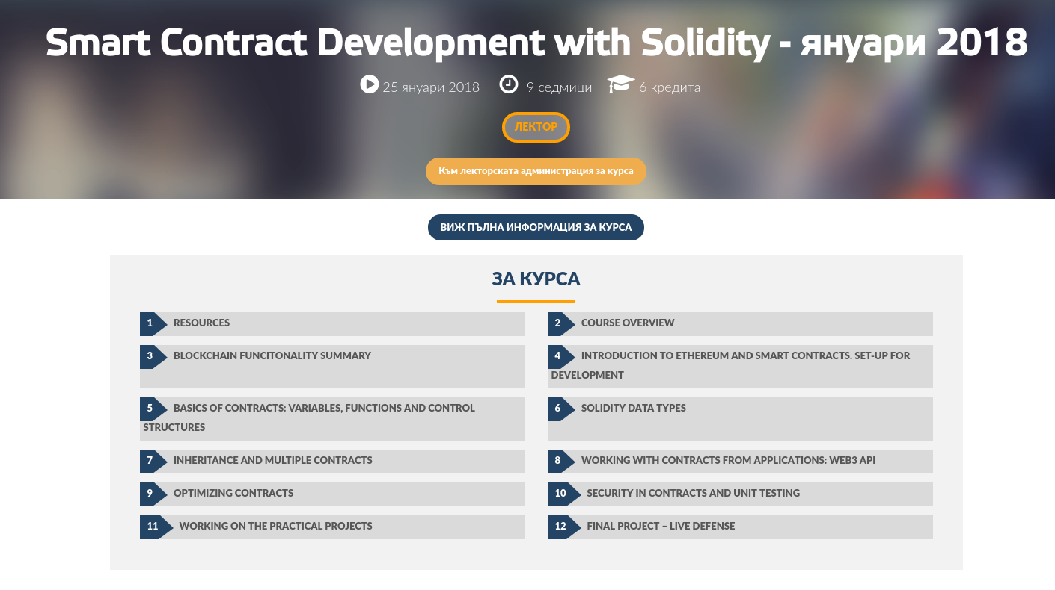

Slide 3
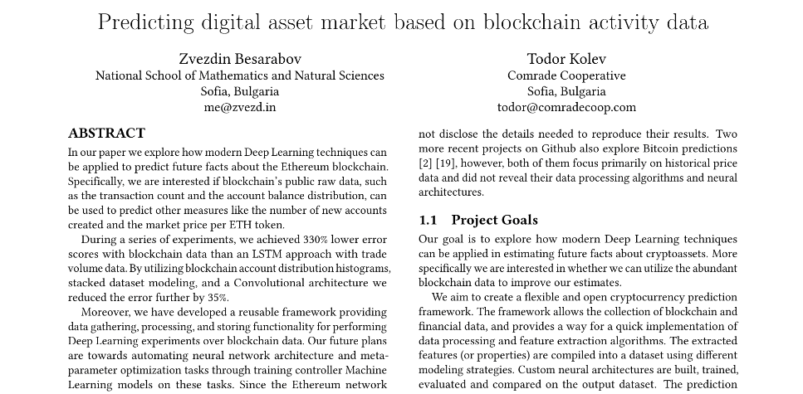

Slide 4
Plan for today
Introduction to Ethereum
Ethereum decentralized applications
Functionality, interface, key moments, pros/cons
Practical part
Hello world, Voting, ERC20 token
Dangers of decentralized applications
Historical events in Ethereum
Forks, DAO / Parity hack
Useful websites

Slide 5
The centralization problem
Pesho
Bank
Gosho
$5
$4,50
Notes:
Проблемът с централизираните банки

Slide 6
Cryptocurrencies - lack of intermediary
Pesho
Gosho
5 ETH
Notes:
Контролът отива в ръцете на потребителите

Slide 7
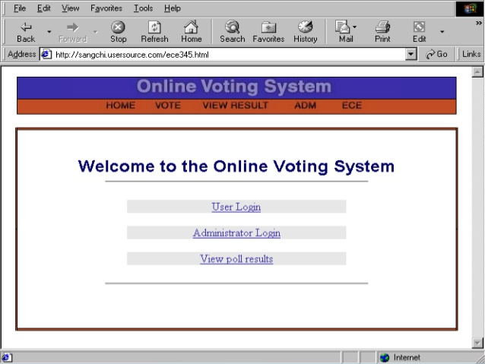
Centralized applications

Slide 8
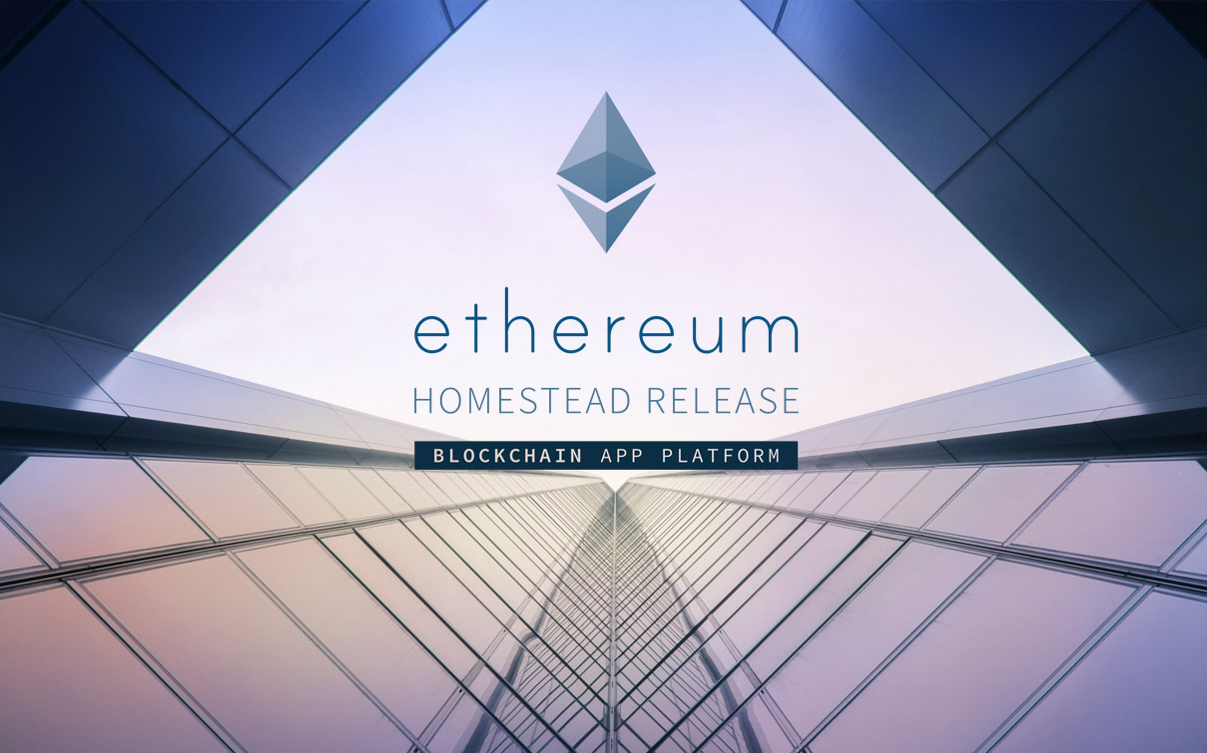
Въведение в Ehereum
Notes:
Платформа за създаване и изпълнение на блокчейн приложения, които обикновено биха изисквали чисто нов блокчейн и мрежа.

Slide 9
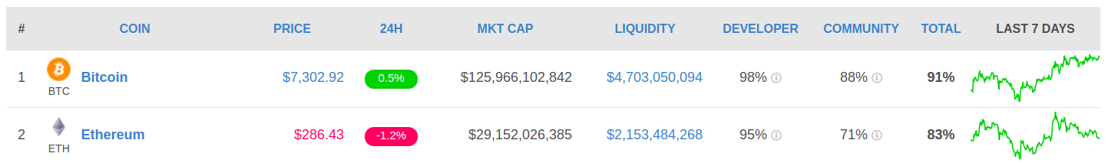
Ethereum

Slide 10
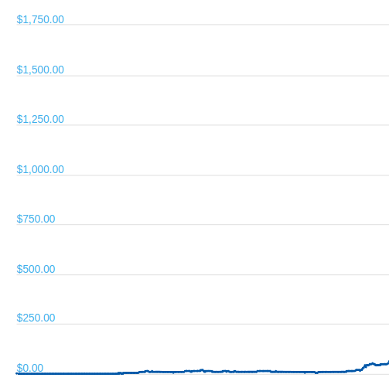
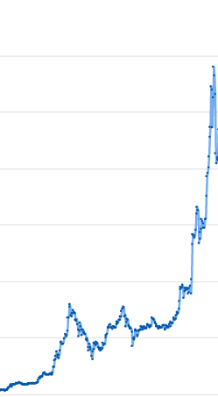
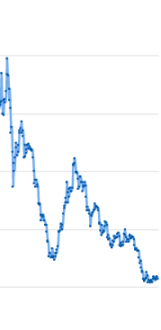
Notes:
Сега малко за Ethereum.

Slide 11
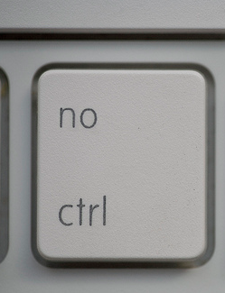
Decentralized applications (contracts)
Code on the blockchain (turing complete)
Decentralized
Autonomous
Immutable
No censorship, control
„Contracts“
Notes:
Причината за този рязък скок са децентрализираните приложения.
Те са като сървър с 100% uptime, и никой не може да отиде и да ръгне флашката та да счупи нещата

Slide 12


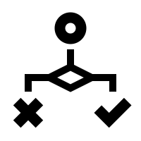

Abilities
Data storage
Logic
ETH Balance
Multicontract interaction

Slide 13


Method of execution
Execution is done on an outside call
Execution is a transaction

Slide 14
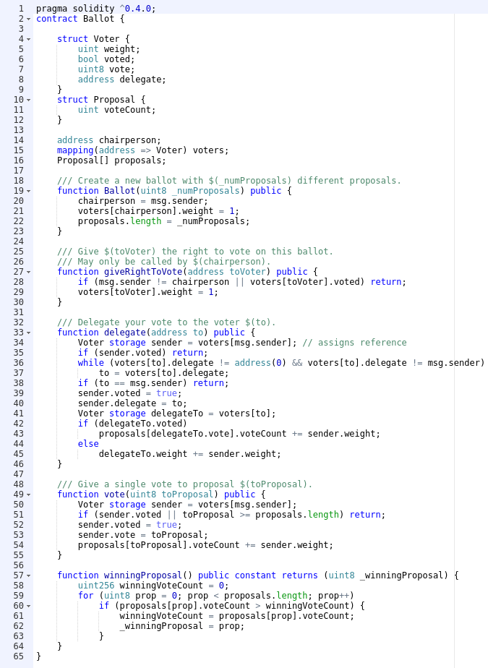

Slide 15

Publicity
Transactions, balances, activity
Contract logic
Data
Accessibility
Prone to attacks

Slide 16
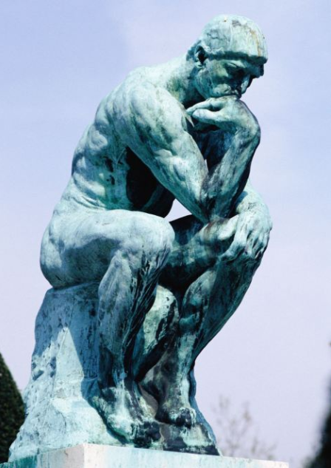
Do you really need a crytpo contract?
Do you really need a crytpo contract?

Slide 17
Practical part

Slide 18

In short: pros
Blockchain guarantee
100% uptime
No censorship
Autonomy
Infinite life
Accessibility
Easy to develop *
Easy to use **
Like a law

Slide 19

In short: cons
Gas expenses
Gas limit
Publicity
Blockchain limitations
No internet access

Slide 20

Smart contract applications
Voting
Freedom of speech
Social networks
Crowdfunding
ICOs

Slide 21

WeTonomy
Framework for cooperation and creation of cooperatives
Based on consensus between members
Rewards hard work

Slide 22
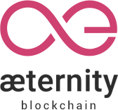
Aeternity
Better Ethereum
Better EVM + 2 languages
Raised a lot from crowdfunding
Strong bulgarian participation
Created an incubator

Slide 23
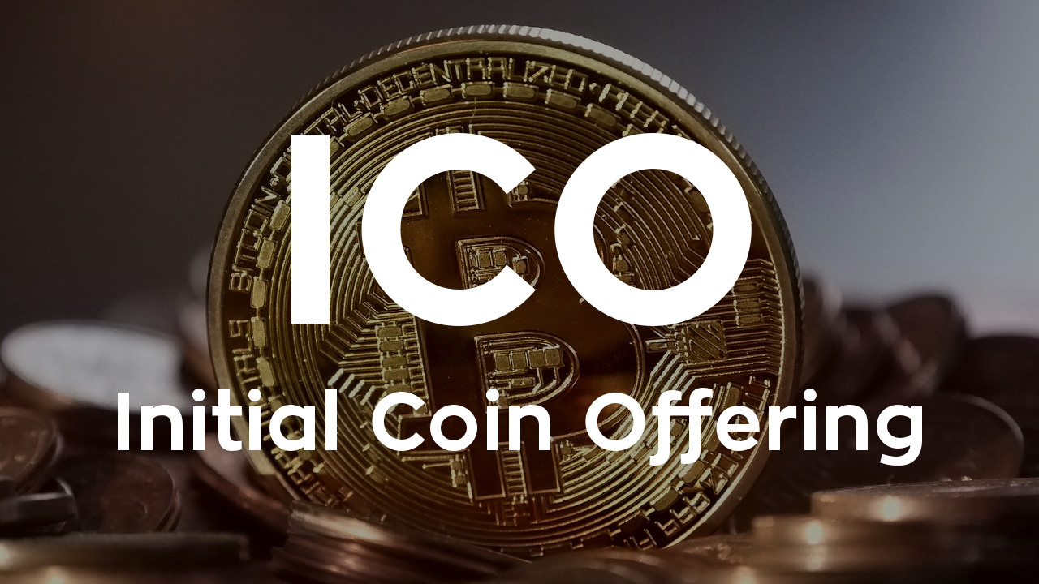
ICOs in a nutshell
Crowdfunding of projects
Public token sale

Slide 24
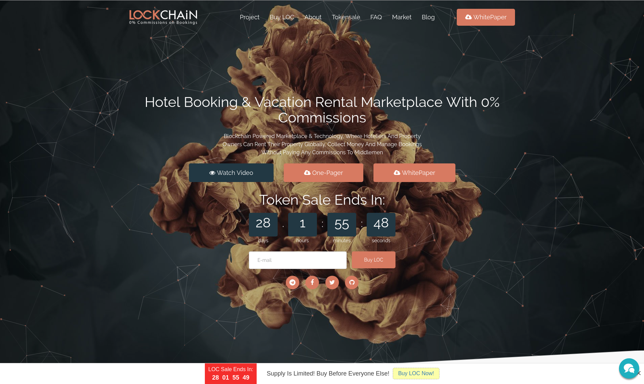

Slide 25
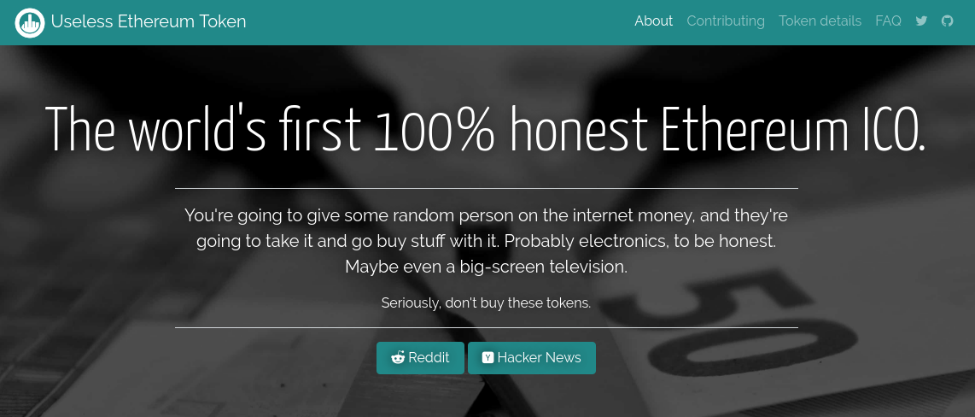
MUST BUY ICO

Slide 26
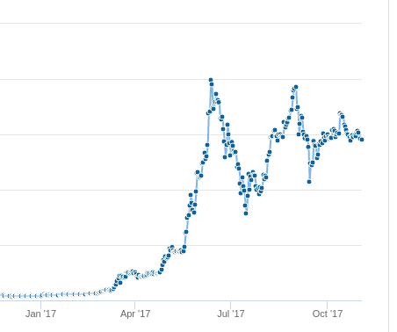
Artificial ETH Price increase
Speculative investment
Boom of ICOs
Bad for contracts
The main objective of Ethereum

Slide 27
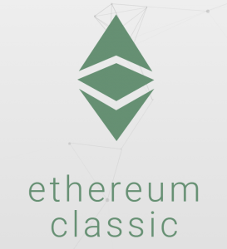
The DAO attack
June 17, 2016
Vulnerability in the DAO
Hacker drained $53M
Resulted in Hard fork
Split into Ethereum and Ethereum classic

Slide 28
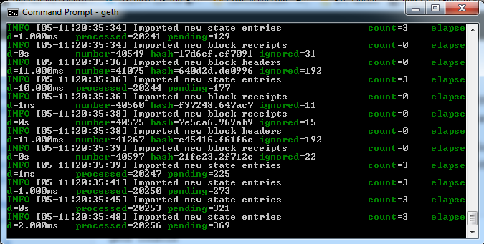
Sep 19, 2016 DOS attack
Vulnerability in GETH
Caused a global crash
During devcon2

Slide 29
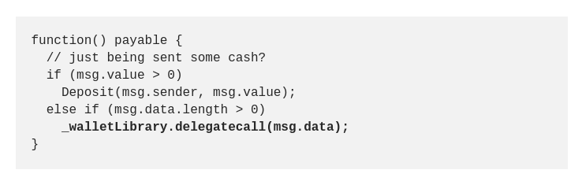
Parity Multi-sig wallet hack
Jul 19, 2017
Vulnerability in Parity’s Multi-sig wallet
150,000 ETH Stolen (~$30M at the time)
Never returned
Aeternity suffered major loss

Slide 30
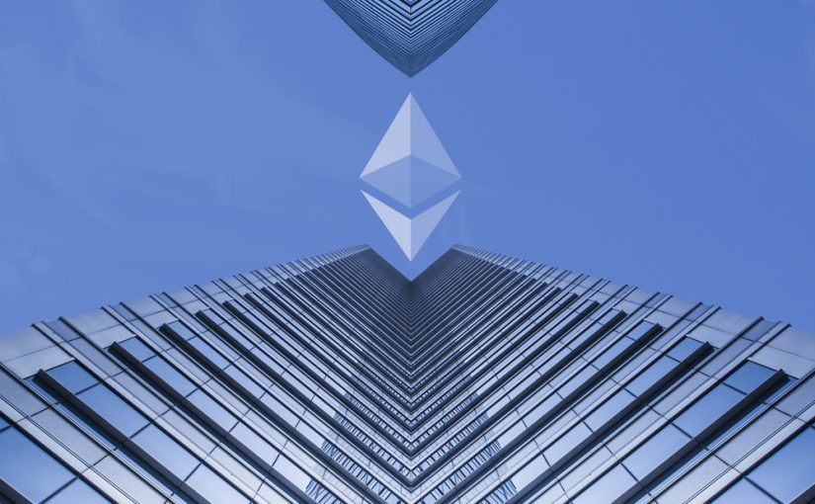
Upcoming Casper Update
Future fork
PoS consensus
Sometime 2017? 2018? 2019?
GPU Mining obsolete

Slide 31
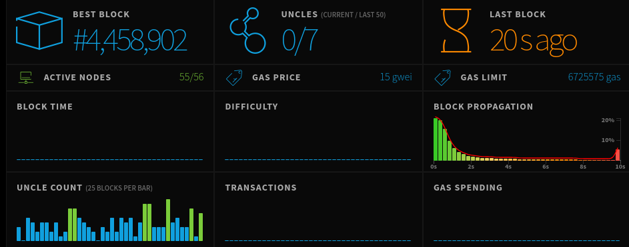
Ethereum network statistics
ethstats.net

Slide 32
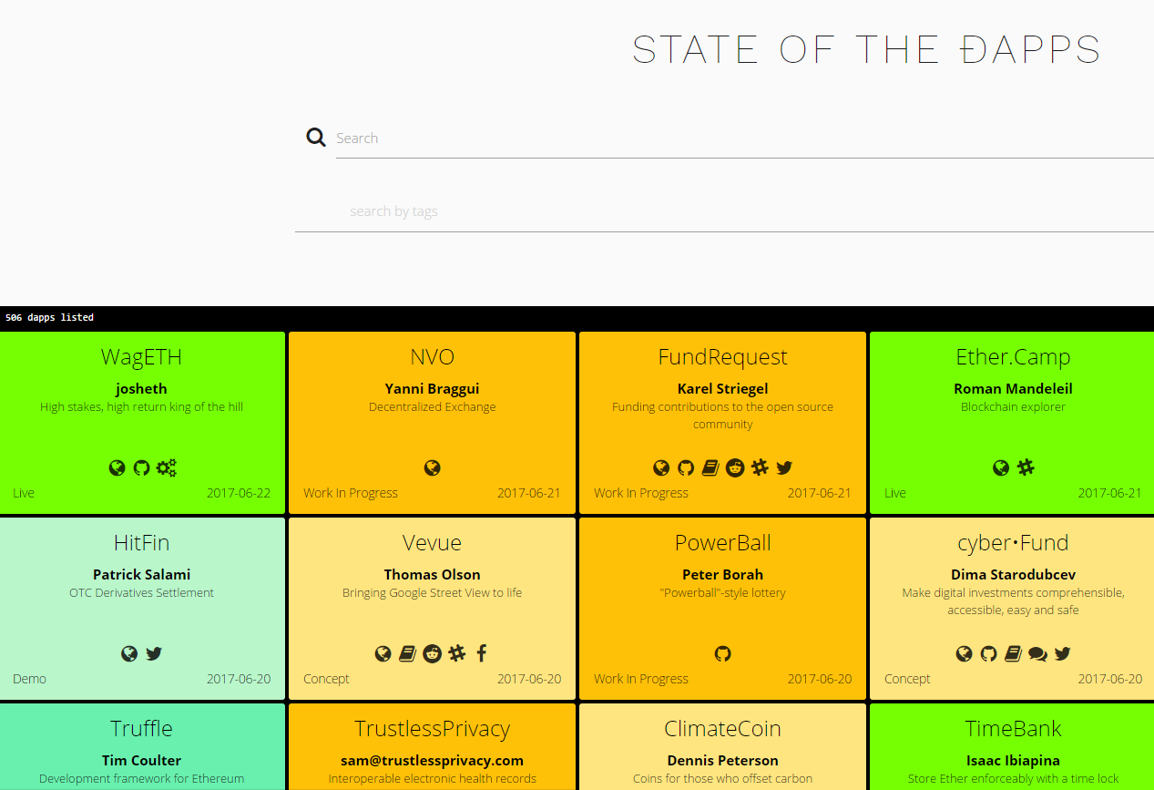
State of the Dapps
dapps.ethercasts.com

Slide 33
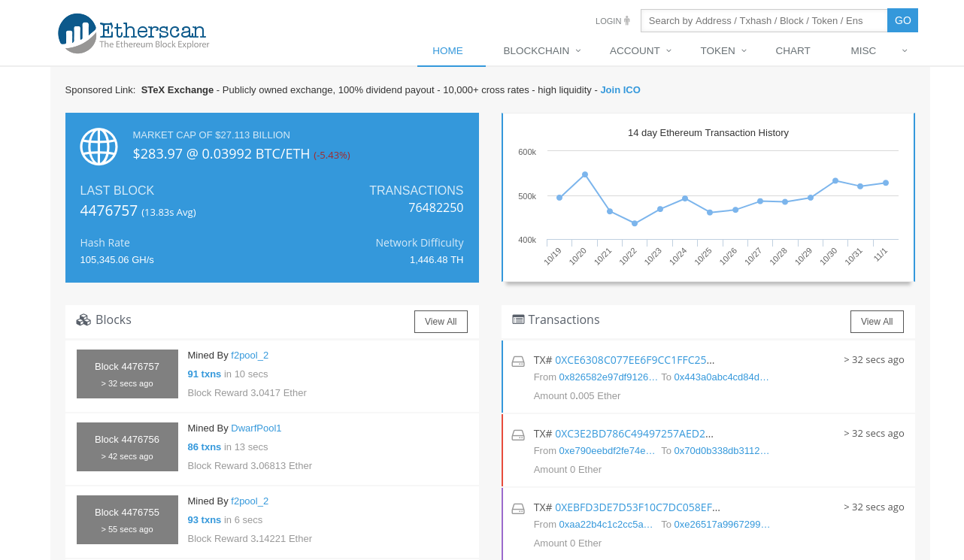
Etherscan.io

Slide 34
Homework (1/2)
Create a contract, that:
Holds a counter state variable (uint)
Has a function that will increment this counter by 1 only if called by the contract owner. If not, it should raise an exception.
Has a getter for the counter
Has overflow protection (don’t hardcode anything related to the type please)

Slide 35
Homework (2/2)
Create a DDNS contract (Decentralized Domain Name System), that:
Has a method to buy a domain name (string type). The price is 1 ETH. A domain cannot be bought if it is already owned by someone
Look up how to send & accept ETH payments using smart contracts (or ask me if you’re stuck)
Has a method to change/set the IP of a domain to a given value. Can only be called by the domain owner. For testing purposes, you can use regular integers instead of IP addresses.
Has a method to get the IP of a given domain.
Has a method that allows the contract owner to withdraw money collected in the contract’s balance from domain purchases
For simplicity, domains cannot expire once they have been purchased.

Slide 36
Homework (2/2) 2.0
…
BONUS: If you create and use your own cryptocurrency token for buying domains instead of ETH
BONUS: Write JS unit tests using the Truffle framework
An example template of the DDNS contract can be found here: http://termbin.com/oefb

Slide 37
Deadline
You can email me your solutions (a git repository would be nice) at git@zvezd.in until 23:59:59 at 7.09 (or later for -20% of max points)

Slide 38
Helpful links
Solidity documentation (Your bible): https://solidity.readthedocs.io
https://ethereum.stackexchange.com/ :)

Slide 39
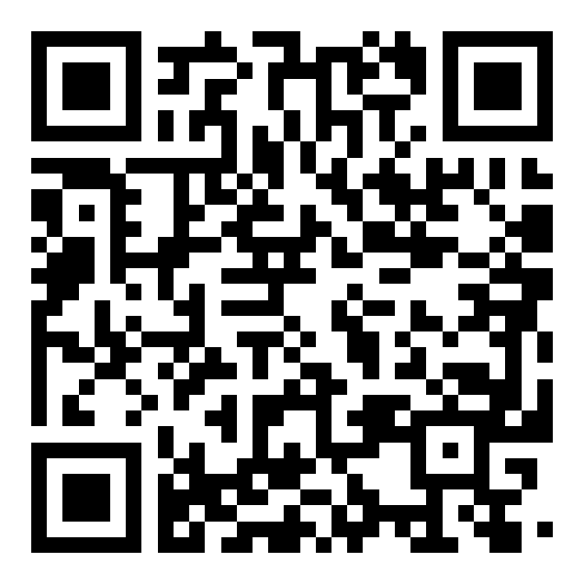
zvezdin@obecto.com

